Slide 1
Research on Teacher Education in Mathematics -- through collaborative inquiry-based processes including teachers and students
APEC - TSUKUBA International Conference – 2015
Barbara Jaworski
Mathematics Education Centre

Slide 2
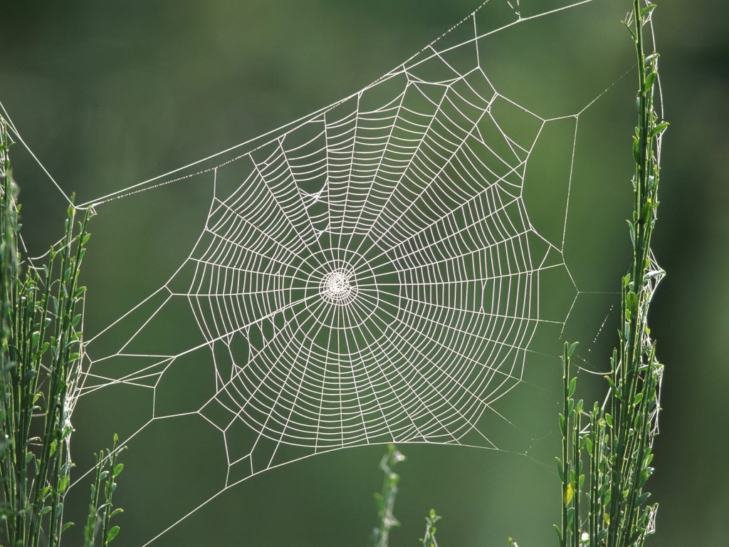
Structure
Collaboration in research and teaching through inquiry
What does it mean to teach mathematics (or science)?
Inquiry in the classroom
The role of the teacher
Inquiry in theory
Collaborative inquiry between teachers and didacticians
Video example from a research project
Collaborative developmental research
Image: http://machprinciple.com/spiders understand-the-music-of-their-web/

Slide 3
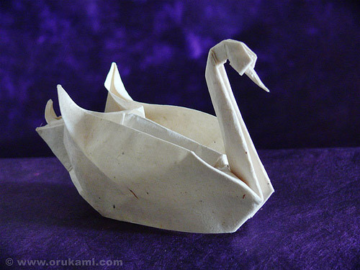
Co-learning inquiry
In a co-learning agreement, researchers and practitioners are both participants in processes of education and systems of schooling.
Both are engaged in action and reflection.
By working together, each might learn something about the world of the other.
Of equal importance, however, each may learn something more about his or her own world and its connections to institutions and schooling.
(Wagner, 1997, p. 16)
Image: The Dance . Designed and folded by H.T.Quyet from 1 uncut right triangle – half of a square size 34×34 cm. (via ORI_Q)

Slide 4
Central concepts
Mathematics
Research
Inquiry
Learning
Teaching
Development
Image from The Uplands Teaching and Learning Blog http://blogs.uplands.org/talg/
Learning Mathematics through Inquiry
Learning Mathematics Teaching through Inquiry
Collaboration in learning and teaching
Communities of practice and inquiry
Critical Alignment
Teachers and didacticians as researchers

Slide 5
What is teaching?
For example, the teaching of a particular concept in mathematics can be understood only within a broader picture of what it means to think mathematically, and its significance and value can be understood only within the wider evaluation of the mathematics programme. (Pring, 2000, p.27)
[not attending to this] is to accept a limited and impoverished understanding of teaching. (Pring, 2004, p. 22)
An action might be described as ‘teaching’ if, first, it aims to bring about learning, second, it takes account of where the learner is at, and, third it has regard for the nature of what has to be learnt. (Pring, 2000, p. 23)
Image is the Harriss spiral is constructed using a simple process of dividing rectangles

Slide 6
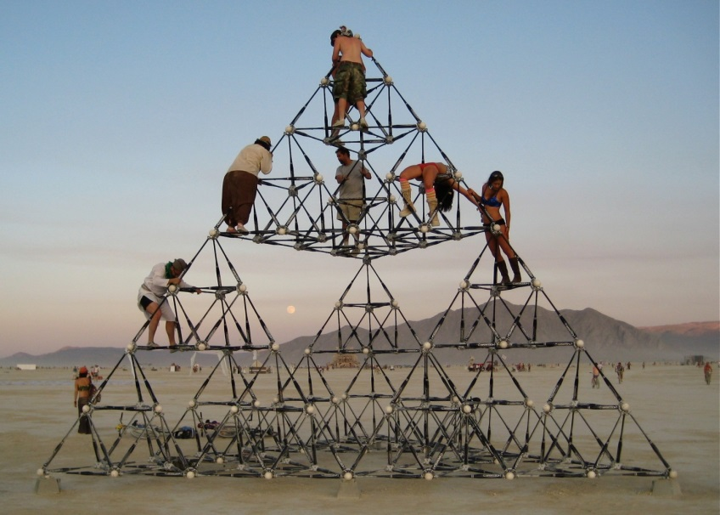
… a moral practice
It is an activity in which the teacher is sharing in a moral enterprise, namely the initiation of young people into a worthwhile way of seeing the world …
… there can be no avoidance of that essentially moral judgement of the teacher over what is worth learning and what are the worthwhile ways of pursuing it.
(Pring, 2004, p. 18)
Teaching … is more than a set of specific actions in which a particular person is helped to learn this or that.
Image a 22ft tall Sierpinski tetrahedron Designed by Gwen Fisher, engineered by Paul Brown.

Slide 7
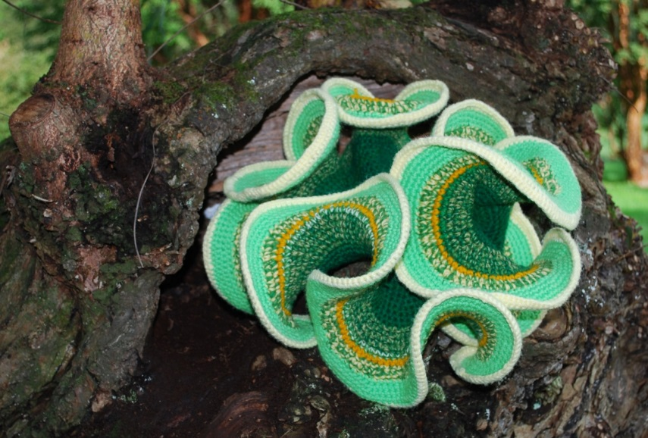
Teaching for conceptual understanding
The initiation of young people into a worthwhile way of seeing the world – the broader picture.
The moral judgement of the teacher over what is worth learning and what are the worthwhile ways of pursuing it.
What is worthwhile in mathematics?
to do mathematics
to use mathematics
to apply mathematics
Requires mathematical understanding
Image is A crocheted model of the hyperbolic plane. Photograph: Daina Taimin http://www.theguardian.com/

Slide 8
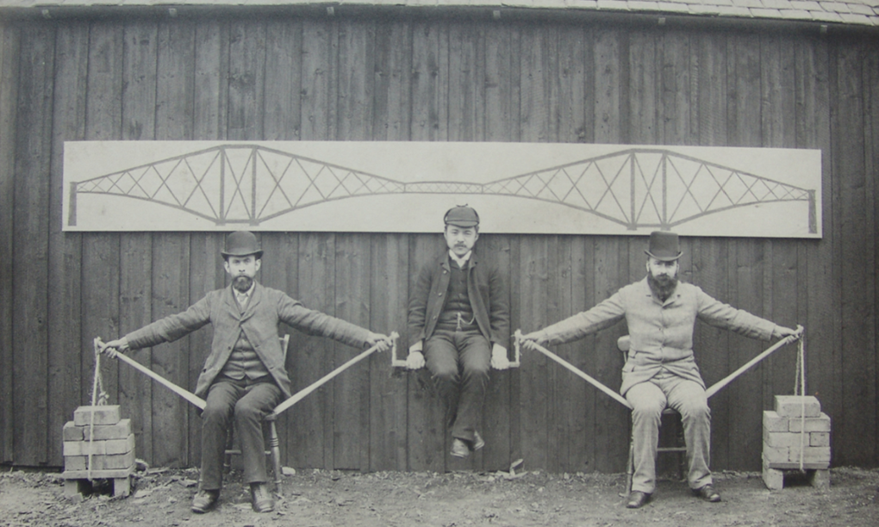
Bringing inquiry into the classroom
A demonstration of the mathematical principles of the original Forth Bridge in Scotland performed at Imperial College in 1887. The central 'weight' is Kaichi Watanabe, one of the first Japanese engineers to study in the UK, while Sir John Fowler and Benjamin Baker provide the supports.

Slide 9
Inquiry in the classroom
Ask questions and seek answers
Recognise problems and seek solutions
Wonder
STUDENTS!
WHO?
Explore
Imagine
Investigate
Reason
Discuss
Look critically

Slide 10
Inquiry-based tasks
Inspire involvement
Provide easy access to mathematical ideas
Enable everyone to make a start
Provide opportunity to ask questions, solve problems, imagine, explore, investigate …
Encourage discussion and reasoning, diverse directions and levels of thinking, fluidity and flexibilility
Encourage student centrality/ownership in/of the mathematics
Promote serious mathematical thinking

Slide 11
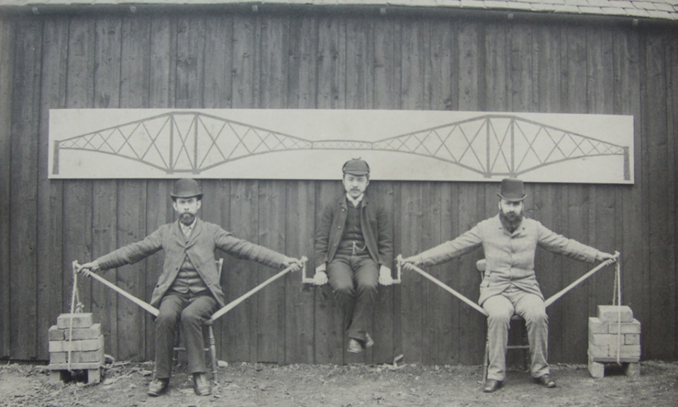
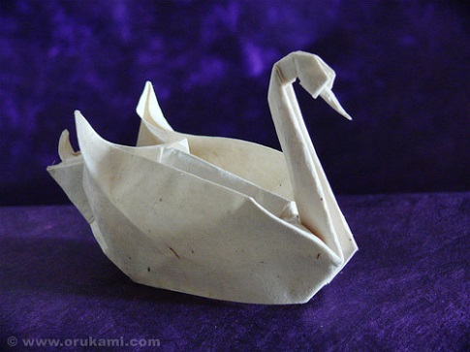
What kinds of tasks am I talking about?

Slide 12
Some inquiry-based problems/tasks
A. Take any natural number and express it as a sum in as many ways as possible (e.g. 10 = 2+8 = 3+2+2+2+1 = 1+1+1+1+6) Multiply the numbers of any sum and find the largest product. Generalise?
B. You have a number of balls in a bag, some red and some white. What is the least number of red balls for which the probability of drawing two red balls in succession (without replacement) is more than 1/3? Generalise?
C. Can you find any plane shape for which the area is numerically equal to its perimeter? Generalise?

Slide 13
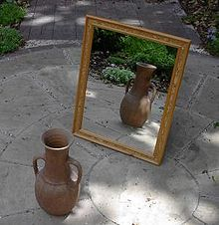
How tall a mirror must you buy if you want to be able to see your full vertical image?
Grade 1
One student faces a mirror holding a stick (against his stomach). This student directs another, who, using a whiteboard marker, marks the mirror image the first one sees. Compare the original stick with the marks on the mirror. Try different distances from the mirror.
Grade 2
One student holds a geometric figure (against the stomach) and explains to another student how to draw (on the mirror) the mirror image he sees. Compare.
Grade 3
Measure yourself in centimetres. Measure your mirror image in centimetres.
Draw yourself seeing yourself in a mirror.

Slide 14
Grade 6
Measure yourself and your mirror image.Draw yourself (simplified) looking ina mirror with the correct ratios (and angles) in your drawing.
Grade 7
Draw model of a figure and an eye and the mirror image the eye sees (keep the
eye and the figure at the same distance from the mirror?). Describe lengths and angles. What do you see?
Grade 8
Hold a cube and go close to the mirror. Draw on the lines of the cube on the
mirror. What do you see?
Grade 11
How tall a mirror must you buy if you want to be able to see your full vertical image?
Justify your conclusion; try with objects with different distances from mirror; describe ratios in your model
Grade 12
How tall a mirror must you buy if you want to be able to see your full vertical image? Justify your conclusion; try with objects with different distances from mirror; describe ratios in your model use the cosine rule to derive the height of the actual figure when the height of the mirror image is known
Grade 13
Draw yourself and a mirror in a three dimensional vector space.

Slide 15
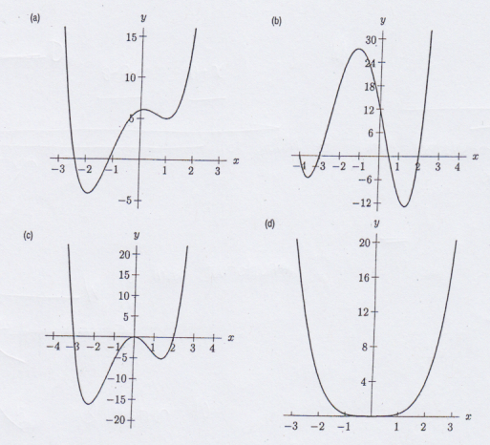
Topic-focused tasks
Given the function f(x) = x² – 3x + 4, x is a real number sketch the function on a pair of axes.
Find the equation of a line that crosses this curve where x=1 and x=2
Find the equation of a line of gradient 3 that crosses the curve twice
Find the equation of a line of gradient -3 that does not cross the curve
Use sliders in GeoGebra to determine which of the graphs below could represent the function y=ax⁴+bx³+cx²+dx+e Here a, b, c, d and e are real numbers, and a≠0. Explain
Jaworski & Matthews, 2011

Slide 16
What is the teacher doing …
… when students work on inquiry-based tasks?
Circulating and listening
Asking, and encouraging students to ask questions
Encouraging dialogue and/or debate
Fostering reasoning
Prompting and challenging
What is the teacher’s role?

Slide 17
Some theoretical ideas
Conjecturing atmosphere (Mason, Burton & Stacey, 1982)
Encouraging students to conjecture and test their conjectures – leading to generalisation, abstraction and proof in mathematics
Teaching triad (Jaworski, 1994)
Management of learning
Sensitivity to students
Mathematical challenge
HARMONY – balance between sensitivity and challenge (Potari & Jaworski, 2002)
ML
SS
MC

Slide 18
Inquiry in classroom mathematics
Students engaging in mathematical tasks that are inquiry-based allows
Multiple directions of inquiry
Making, testing and justifying mathematical conjectures
Multiple levels of engagement
Mutual engagement and support
Differing degrees of challenge
Harmony in balancing sensitivity and challenge
Acceptance of and respect for difference

Slide 19
Inquiry in mathematics teaching
Involves teachers-as-inquirers exploring
the kinds of tasks that engage students and promote mathematical inquiry
ways of organising the classroom that enable inquiry activity with all its attributes
The many issues and tensions that arise related to the classroom, school, parents, educational system, society and politics.
and reflecting on what occurs in the classroom with feedback to future action

Slide 20
An inquiry cycle
e.g.,
Design a particular
classroom task
Plan for teaching
Act and observe
Reflect and analyse
Feedback to future planning
Use the task in the classroom and observe what happens -- gather data
Reflect on what occurred -- analyse the data
Use what has been learned through observation and analysis to redesign the task
Action research
Iterative and
systematic
Design research
(Jaworski, 2004)

Slide 21
Inquiry in two layers
Inquiry in students’ mathematical activity in the classroom
Inquiry in teachers’ exploration of classroom approaches

Slide 22
Two communities of inquiry
Inquiry in classroom mathematics – -- students (& teacher)
Inquiry in planning
for the
classroom
-- teachers (& teacher educators -- didacticians)

Slide 23
Theoretical background: Community of Practice
From Vygotskian theory (e.g., Vygotsky, 1978, Wertsch, 1991)
Learning as participation in social action mediated by tools and signs
From Wenger’s “Community of Practice” (CoP) (Wenger, 1998)
Mutual engagement; Joint enterprise; Shared repertoire
Wenger’s notion of belonging to a CoP, involves
Engagement; Imagination; Alignment
BUT Alignment can result in perpetuation of unhelpful practices (e.g., instrumental learning and teaching in mathematics (e.g., Skemp 1985)

Slide 24
From community of practice …
to Community of Inquiry
Involves
Engagement
Imagination
and
Alignment
Perpetuation of established practices
(Brown and McIntyre, 1993)
Inquiry
– new kinds of engagement
Critical alignment

Slide 25
Critical Alignment in Practice
We look critically at our practice, while we engage and align with it
Ask questions about what we are doing and why
Reveal and question implicit assumptions and expectations
Try out innovative approaches to explore alternative ways of doing and being to achieve our fundamental goals

Slide 26
Creating a Community of Inquiry
transformation
Within a community of practice
Ask questions and seek answers
Recognise problems and seek solutions
Wonder, imagine, invent, explore …
Look critically: ‘critical alignment’ leads to ‘metaknowing’
(Jaworski, 2006; 2008; Wells, 1999)
Community of inquiry
From inquiry as a tool
To inquiry as a way of being in practice
Establishing an inquiry identity

Slide 27
An inquiry identity
Having an inquiry identity is more than (just) doing the occasional inquiry-based task in the classroom.
It involves being an inquirer in all our professional activity
designing and using inquiry-based tasks with students
encouraging students to ask their own questions and explore aspects of mathematics for themselves
Questioning our own approaches to teaching
Dealing with issues in teaching, in collaboration with colleagues
Exploring (new) approaches to teaching, with our colleagues
Working with didacticians to develop teaching.

Slide 28
Collaborative inquiry
Two groups of people have important knowledge to bring to teaching development
Teachers
Teacher educators/researchers (didacticians)
Together, these kinds of knowledge can be powerful in the developmental process.

Slide 29
How is knowledge distributed?
Systemic and cultural settings and boundaries within which learning and teaching are located
Didacticians
Teachers
Knowledge shared by didacticians and teachers: e.g.
mathematics pedagogy
didactics
Didacticians’ knowledge of theory, research and systems
Teachers’ knowledge of students and schools

Slide 30
Inquiry in three layers
Inquiry in mathematics
Inquiry in students’ mathematical activity in the classroom
Inquiry in teachers’ exploration of classroom approaches
Inquiry in addressing questions and issues to do with teaching and how it can develop to promote mathematics learning.
Inquiry in mathematics teaching
Inquiry in research
into learning and teaching
mathematics

Slide 31
Developmental research in Norway
A project involving a team of didacticians and teachers in 8 schools
3 phases over 3 school years
Based in inquiry at three levels
Workshops in the university led by didacticians
Developmental work in schools led by teachers
Video compilation

Slide 32
Developmental research/inquiry
Students engage in inquiry in mathematics in the classroom.
Teacher-researchers together explore ways of engaging with students using inquiry-based tasks to promote learning
Didactician-researchers encourage teachers collaborative inquiry and research the processes and practices involved.
Lesson Study fits this model

Slide 33
Thank you for listening

Slide 34
References
Brown, S., & McIntyre, D. (1993). Making sense of teaching. Buckingham, UK: Open University Press.
Eraut, M. (1995). Sch¨on shock: A case for reframing reflection-in-action? Teachers andTeaching: Theory and Practice, 1(1), 9–22.
Jaworski, B. (1988). ‘Is’ versus ‘seeing as’. In D. Pimm (Ed.). Mathematics Teachers and Children. London: Hodder and Stoughton.
Jaworski, B. (1994). Investigating Mathematics Teaching. London: Falmer Press
Jaworski, B. (2003) Research practice into/influencing mathematics teaching and learning development: towards a theoretical framework based on co-learning partnerships. Educational Studies in Mathematics 54, 2-3, 249-282
Jaworski, B. (2004). Insiders and outsiders in mathematics teaching development: the design and study of classroom activity. Research in Mathematics Education, 6, 3-22.
Jaworski B. (2006). Theory and practice in mathematics teaching development: Critical inquiry as a mode of learning in teaching. Journal of Mathematics Teacher Education, 9(2), 187-211.
Jaworski, B., Fuglestad, A. B., Bjuland, R., Breiteig, T., Goodchild, S., & Grevholm, B. (Eds.), (2007). Learning communities in mathematics. Bergen, Norway: Caspar.
Jaworski, B., Goodchild, S., Daland, E., & Eriksen S. (2011). Mediating mathematics teaching development and pu-pils’ mathematics learning: the life cycle of a task. In O. Zaslavsky & P. Sullivan (Eds.), Constructing knowledge for teaching secondary mathematics: Tasks to enhance prospective and practicing teacher learning. New York: Springer. Jaworski, B., Fuglestad, A. B., Bjuland, R., Breiteig, T., Goodchild, S., & Grevholm, B. (Eds.). (2007). Learning communities in mathematics. Bergen, Norway: Caspar.
Jaworski, B. & Matthews, J. (2011) Developing teaching of mathematics to first year engineering students. Teaching Mathematics and Its Applications 30(4): 178-185

Slide 35
Mason, J., Burton, L. & Stacey, K. (1982). Thinking Mathematically. London: Addison Wesley
McIntyre, D. (1993). ‘Theory, Theorizing and Reflection in Initial Teacher Education.’ In J. Calderhead and P. Gates (Eds.), Conceptualising Reflection in Teacher Development (pp. 39-52). London, Falmer.
Potari, D. & Jaworski, B. (2002). Tackling complexity in mathematics teaching. Journal of Mathematics Teacher Education, 5, 4, 351-380.
Pring, R (2000). The Philosophy of Educational Research. London: Continuum.
Pring, R. (2004). Philosophy of Education. London: Continuum.
Open University (1985). Working Mathematically with Low Attainers: Centre for Mathematics Education Research Study. Milton Keynes: Open University.
Rowland, T., Huckstep, P. & Thwaites, A. (2005). Elementary Teachers Mathematics Subject Knowledge. Journal of Mathematics Teacher Education, 8, 3, 255-281
Skemp, R. (1989). Mathematics in the primary school. London: Routledge.
Smith, A. (2004). Making mathematics count. The report of Professor Adrian Smith’s inquiry into post-14 mathematics education. London: The Stationery Office.
Stenhouse, L. (1984). Evaluating curriculum evaluation. In C. Adelman (Ed.). The Politics and Ethics of Education. London: Croom Helm.
Vygotsky, L. (1978). Mind in society. Cambridge, MA: Harvard University Press.
Wagner, J. (1997). The unavoidable intervention of educational research: A framework for reconsidering research-practitioner cooperation. Educational Researcher, 26(7), 13–22.
Wells, G. (1999). Dialogic inquiry: Toward a sociocultural practice and theory of education. Cambridge, UK: Cambridge University Press.
Wenger, E. (1998). Communities of practice: Learning, meaning and identity. Cambridge, UK: Cambridge University Press.
Wertsch, J. V. (1991). Voices of the mind. Cambridge, MA: Harvard University Press.

Slide 37
Turning “I can’t” into “I can and I did” (Open University, 1985)
A teacher set her class the following task: If a number of circles intersect in a plane, how many regions can be created? What is the maximum number?
Pupils used hoops on the ground or drew circles on paper or on the whiteboard
1 circle 1 region
2 circles, 3 regions
3 circles, 7 regions
Conjecture: the number of regions for n circles is [2^{n} – 1]
Test: when n=4 [2^{n} – 1] = [2⁴ – 1] = 15
4 circles, 13 regions
5 …
1 1
2 3
3 7
4 13
?
? ?
?

Slide 38
Mary had done something different …
Opportunity for all, allows one to be different
She brought it to the teacher.
The teacher discussed with her what she was finding from this investigation.
Then finally the teacher said:
“You’re doing something different from
everyone else, Mary. Don’t worry, that’s fine.
Just ignore what everyone else is doing”
1 1
2 3
3 5
4 7
9
. .
. .

Slide 39
What shape is it? (Jaworski, 1988)
Look at the figure here.
What is it?
What shape is it?
A class of 12 year olds had been asked by their teacher to name the above shape, which he had drawn on the board. Someone said that it was a trapezium. Some students agreed with this, but not all.
The teacher said, ‘If you think it’s not a trapezium then what is it?’ Michael said, tentatively, ‘It’s a square …’
There were murmurings, giggles, ‘a square’?! … But Michael went on ‘… sort of flat.’

Slide 40
Contingency (Rowland, Huckstep & Thwaites, 2005)
The teacher looked puzzled, as if he could not see a square either. He invited Michael to come out to the board and explain his square. Michael did.
He indicated that you had to be looking down on the square – as if it were on your book, only tilted. He moved his hand to illustrate.
‘Oh’ said the teacher. ‘Oh, I think I see what you mean … does anyone else see what he means?’ There were more murmurings, puzzled looks, tentative nods.
Then the teacher drew …
Oooooh yes (!) said the students and there were nods around the class.
Responding in the moment to something different (inquiring) --and using it for a good outcome for all

